Slide 1


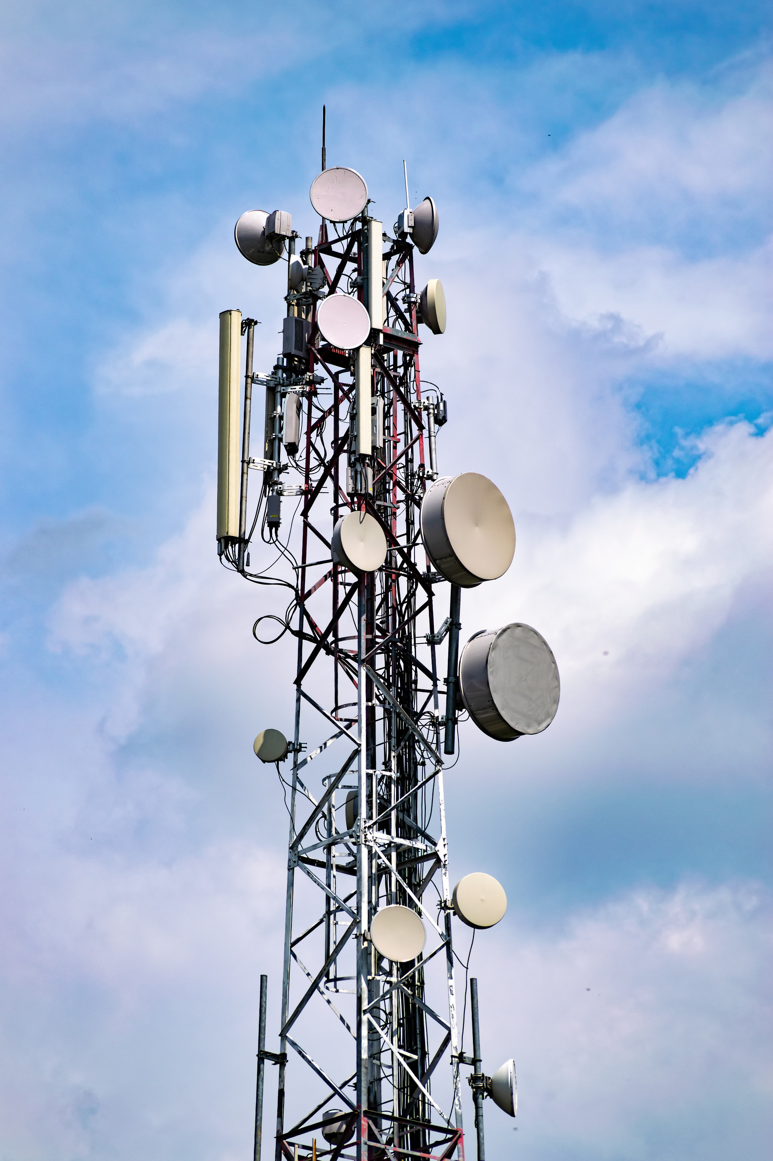
Predicting Customer Churn in Telecom
A Machine Learning Approach
By Hans Darmawan - JCDS2602

Slide 2

Overview
CRISP-DM Approach
Business Understanding
Data Understanding
Data Preparation
Modeling
Evaluation
Deployment
Conclusion and Recommendations

Slide 3

1. Business Understanding
Background
Gap Analysis
Problem Statement
Goals
Analytic Approach
Metric Evaluation
Success Criteria

Slide 4

Business Understanding
Customer Churn Definition
Customer churn in telecom refers to the rate at which customers stop using services, significantly impacting revenue and profitability.
Causes of Churn
Factors contributing to customer churn include dissatisfaction with service quality, pricing, customer support, and competitive offers.
Importance of Retention
Retaining existing customers is more cost-effective than acquiring new ones, making churn management crucial for financial health and growth.
Background

Slide 5
Business Understanding
Lack of Predictive Model
The company currently lacks a predictive model to identify at-risk customers, hindering effective retention strategies.
Data Quality and Engagement Issues
There are significant gaps in data quality and stakeholder engagement that impact informed decision-making.
Need for Continuous Improvement
1.Establishing a process for continuous improvement is essential to adapt to changing customer behaviors and integrate predictive insights into operations.
Gap Analysis

Slide 6
Business Understanding
Which customers are likely to churn?
Identifying At-Risk Customers: The primary question is to determine which customers are likely to churn.
What factors influence customer churn the most?
Influential Factors: Understanding the key factors that influence customer churn is crucial for developing effective strategies.
How can the company reduce churn and improve customer retention?
Strategies for Retention: Finding ways to reduce churn and improve customer retention is a central concern for the company.
Problem Statement

Slide 7
Business Understanding
Develop Predictive Model
Create a model to classify customers as likely to churn or not, using historical data and machine learning techniques.
Identify Key Features
Analyze which factors most significantly impact customer churn to inform retention strategies.
Actionable Insights
Provide insights that enable the company to implement targeted strategies to reduce churn, such as personalized plans and improved customer support.
Goals

Slide 8
Business Understanding
Rule Based
Widely used by companies.
Machine Learning Based
To overcome rule-based limitations: uncovering hidden patterns in customer behavior.
Approaches

Slide 9
Business Understanding
Customer Acquisition Cost (CAC)
CAC measures the total cost of acquiring a new customer, essential for evaluating marketing efficiency and profitability.
Customer Retention Cost (CRC)
CRC reflects the costs associated with retaining customers, including salaries and loyalty programs.
Recall as Evaluation Metric
Recall is critical for assessing the effectiveness of churn prediction models, focusing on capturing at-risk customers for targeted retention efforts.
Metric Evaluation

Slide 10
Business Understanding
High Recall Performance
Achieve a recall rate of 80% or higher for effective churn prediction.
Reliable Prediction Model
Develop a dependable model that accurately predicts customer churn.
Reduce Customer Acquisition Cost and Retention Cost.
Achieve a total annual cost reduction rate of 20% or higher.
Interpretable Insights
Provide insights that are interpretable and actionable for informed business decisions, ultimately reducing acquisition and retention costs.
Success Criteria

Slide 11
2. Data Understanding
Dataset Information
Missing Values Checking
Duplicated Values Checking
Exploratory Data Analysis (EDA)

Slide 12
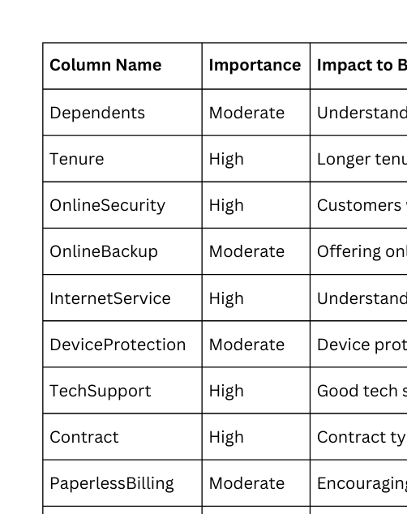
Data Understanding
Dataset Information

Slide 13
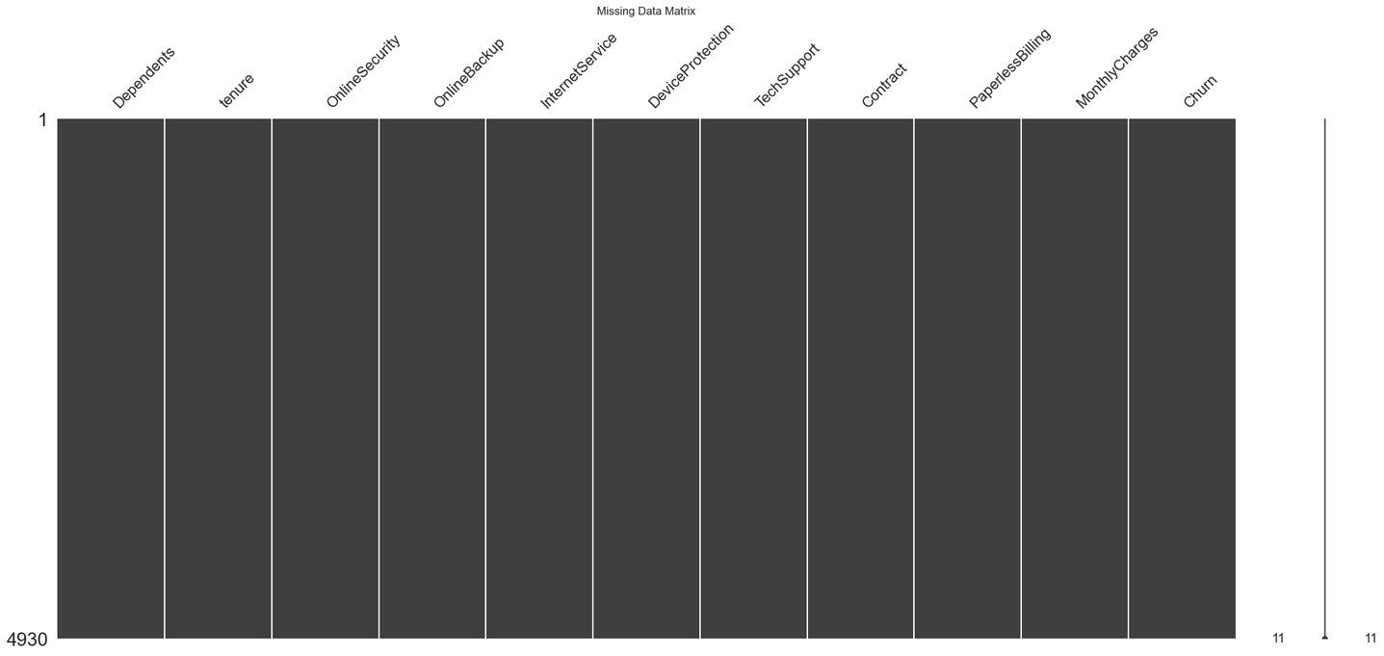
Data Understanding
 | Missing Values Checking
 | No missing values. No need to use imputer in pre-processing.

Slide 14
Data Understanding
Validity of Duplicates
Duplicated rows may represent legitimate repeated observations or transactions, crucial for accurate analysis, particularly in datasets involving transactional data or repeated measurements.
Impact on Data Integrity
Removing duplicates without understanding their context can distort data distributions and compromise data integrity, potentially leading to misleading results and affecting the validity of analyses.
Analytical Significance
Duplicates can provide meaningful information in certain analytical methods and visualizations, highlighting the importance of assessing their origin and significance before deciding to remove them.
Duplicated Values Checking
Number of duplicated rows: 77
Action: Retain Duplicates

Slide 15
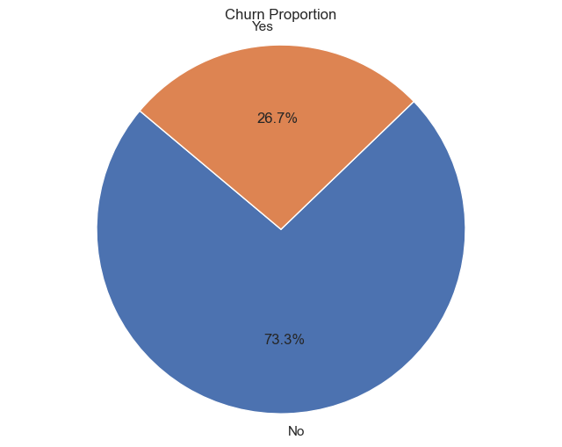
Data Understanding
 | EDA - Churn Proportion
 | Churn: 26.7 % Not Churn: 73.3% Imbalanced Dataset Need to oversampling dataset

Slide 16
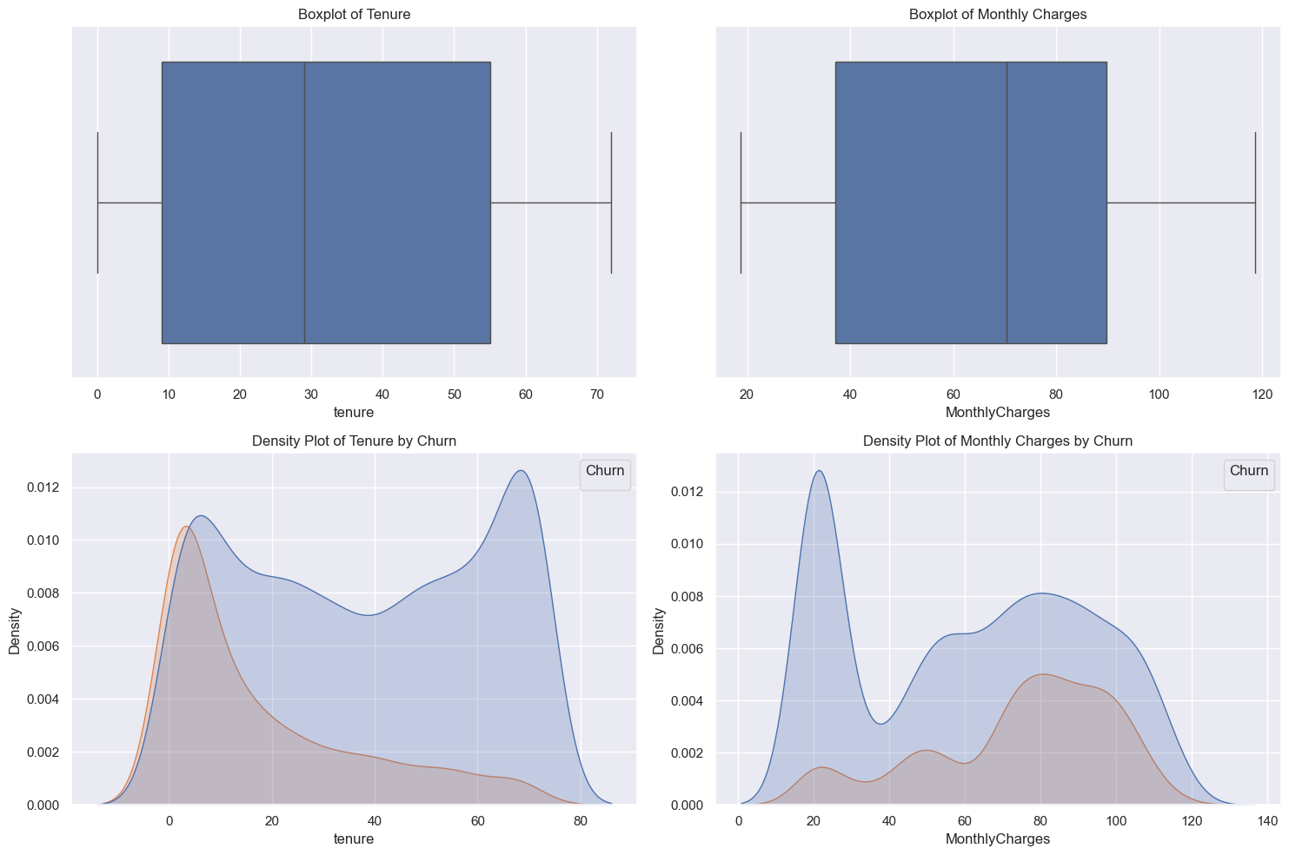
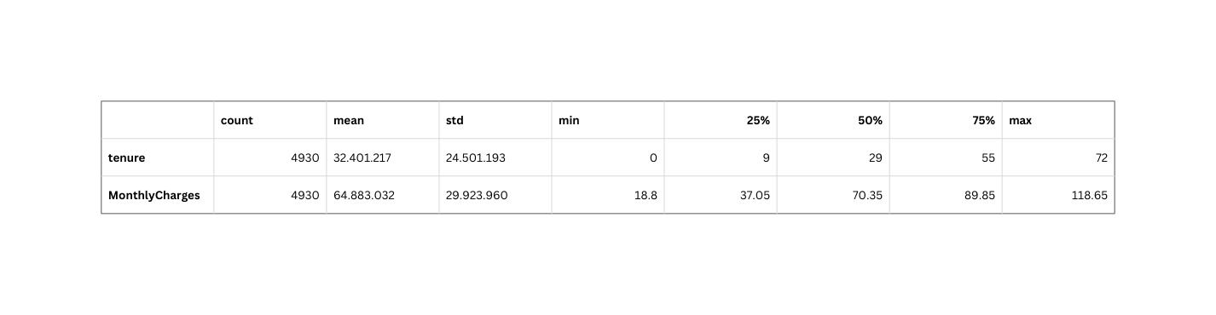
Data Understanding - EDA - Numerical Features Analysis
No negative values Not normally distributed Action: Benchmark MinMax and Robust Scaler in Preprocessor

Slide 17
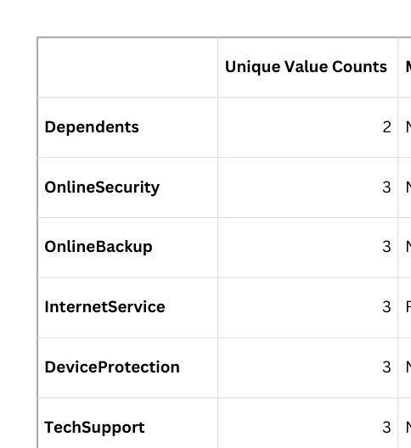
Data Understanding
 | EDA - Categorical Feature Analysis
 | All categorical columns are nominal, except Contract columns (ordinal). Actions: To use ordinal encoder for Contract columns and one hot encoder for the rest while pre-processing.

Slide 18
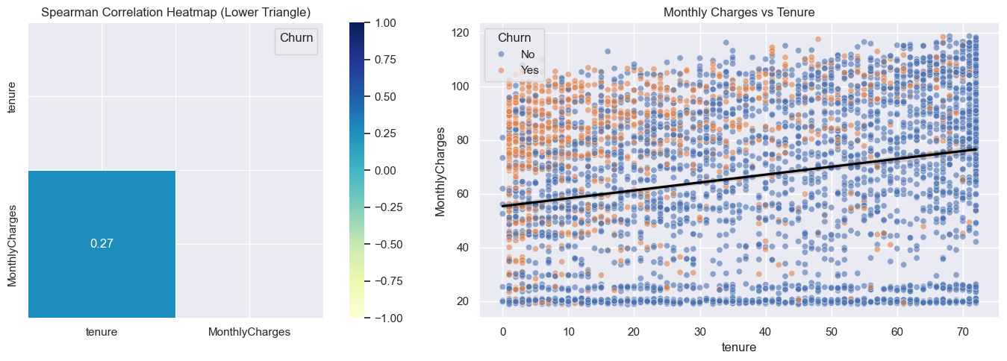
Data Understanding
Correlation Analysis
Low monotonic relationship Directly proportional

Slide 19
3. Data Preparation
Feature Engineering
Binning
Target Labeling
Define X and y
Train-Test Split
Data Transformation Setup

Slide 20
Data Preparation
Feature Engineering
Total Charges = tenure x Monthly Charges
Binning
Equal frequencies based on quarter quantile on tenure, monthly charges, and total charges.
Target Labeling
Churn ⟶ 1, Not Churn ⟶ 0
Define Features and Target
Features (X): All columns except Churn Target (y): Churn

Slide 21
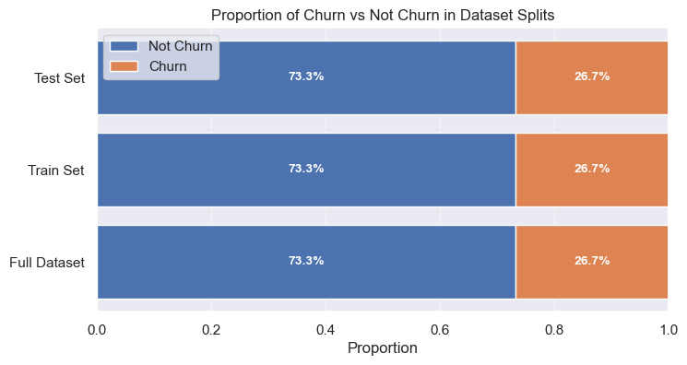
Data Preparation
 | Train-Test Split
 | Train Size: 80 % Test Size: 20 % Stratify on target

Slide 22
Data Preparation
Data Transformation Setup
Step 1
Step 2
Step 3
Step 4
Step 5
Identify Columns
Define Ordinal Categories
Binary Mapping Function
Numeric Transformer Pipeline
Preprocessor Creation
Extract categorical columns (excluding Churn and Contract), numeric columns, and binary columns (with exactly 2 unique values) to categorize the data appropriately for preprocessing.
Create a preprocessor that combines transformations for numeric, binary, ordinal, and categorical features, allowing for a streamlined and efficient data preparation process.
Specify the ordinal categories for the Contract column to ensure that the model understands the inherent order in these categories during training.
Create a function to map binary values ('No' to 0 and 'Yes' to 1) to convert categorical binary features into a numerical format suitable for machine learning algorithms.
Define a pipeline for scaling numeric features using a specified scaler (e.g., RobustScaler or MinMaxScaler) to standardize the range of numeric data and improve model performance.

Slide 23
4. Modeling
Model Initialization and Benchmarking
Hyperparameter Tuning
Evaluate Best Model on Test Data
Learning Curve
Threshold Tuning

Slide 24
5. Evaluation
Feature Importance Using LIME Analysis
Rule Based vs Machine Learning Based

Slide 25
6. Deployment
Joblib Deployment
Model Limitations

Slide 26
7. Conclusion and Recommendations
Summary
Conclusion
Business Recommendations
Model Recommendations

Slide 27
The Difference in Communication
Before 5G Technology | With 5G Technology
The pre-5G internet experience was slower and limited to certain spectrum types. Previous mobile network generations did not entirely support new services that rely heavily on communications. There were significantly more issues and limitations to availability and reliability. | 5G technology's design includes an impressive increase in network efficiency and traffic capacity. It is designed to support all spectrum types, bands, and deployment models. 5G guarantees high speeds that will significantly impact every industry.

Slide 28
Mobile Networks
and 5G Technology
1G
2G
3G
4G
5G
1980s
1990s
2000s
2010s
Current
A network limited to only voice
call capabilities.
GSM, GPRS,
and EDGE advancements
Allowed faster communication, web browsing,
and video streaming
in smartphones
Greatly impacted the requirements set by
IMT-Advanced standards.
Significantly faster speeds with lower requirements
to support
IoT devices

Slide 29
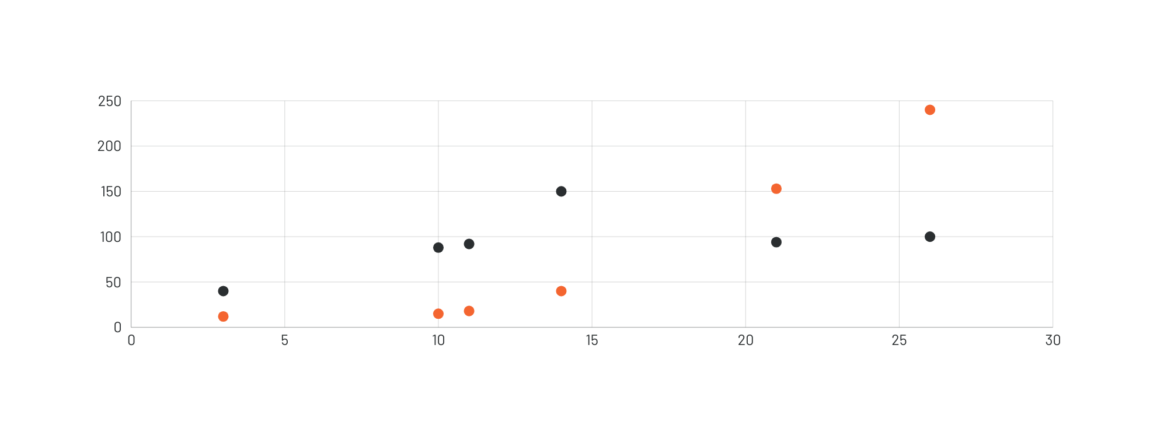
5G Technology Adoption in the World
As of January 2021
5G technology adoption continues to rise
in more countries and cities.

Slide 30

Why 5G Is Better
Than 4G
The next generation of wireless technology
that will transform life significantly
5G technology guarantees a faster and smoother transmission of data, no matter how high the amount. Users can look forward to faster downloads and better support for more connected devices.

Slide 31
The Benefits
of 5G Technology

Slide 32
Benefits for Businesses
5G technology can support operations to improve processes,
produce better results, and remain at the top of their game
No network issues | Lower latency | Greater data capacity
5G will bring a connection speed that's significantly faster than 4G, meaning more data transfer in less time, promising results without delay. | Lower latency will improve IoT devices' safety and functionality, allowing real-time viewing and guaranteeing zero lags in operations. | 5G can support more devices and allow simultaneous data transfer because of its larger spectrum band.

Slide 33
Benefits in Daily Life
Elevated streaming experience
Nothing says excellent entertainment, quite like uninterrupted streaming. Thanks to 5G, we can enjoy unlimited data capacity, short lag times, and multisensory digital content.
Better coverage for smartphones
No more difficulty getting connected -- 5G brings better signal to places that were once difficult to reach. Enjoy stronger connections and better communication with 5G.
Road safety
Self-driving cars will soon become the new norm. But motorists can also enjoy better data processing between vehicles and networks - that means safety on the road and improved traffic management.
It may take years before we experience the full potential of 5G, but that doesn't mean we can't enjoy what it can already offer us.

Slide 34
Other Benefits of 5G Tech
Industry | Impact Brought By 5G
Healthcare | 5G can support real-time transfer of patients’ crucial data and vital signs, such as heart rate, respiratory rate, blood pressure, and oxygen saturation, among others
Transportation/ Automotive | 5G can help monitor vehicle health and streamline route planning, traffic data, and transportation systems.
Energy | 5G can help automate energy-related operations, thus improving efficiency and staff safety
The connectivity that 5G offers will also boost aspects of
various industries
Highlight two or more cells, right-click then choose "Merge Cells" to organize your table according to your needs!

Slide 35
Does 5G technology
really pose health risks?
Health risks from using 5G, debunked
As popular as 5G is becoming, many believe it is a source of cancer and COVID-19. Radiation associated with 5G is believed to cause cancer and weaken the immune system, making it susceptible to the spread of COVID-19. Experts believe both are highly unlikely to have no proven link between COVID-19 infections, cancer, and 5G networks.

Slide 36
As exciting and appealing as 5G technology is, there are a few cons to it: its impact on battery life, high costs for rollout, and imbalance in upload and download speeds.

Slide 37
Trends and the Future of Telecommunications
Artificial intelligence that keeps behind-the-scenes operations rolling faster will guarantee business optimization like never before.
Robotic Process Automation will significantly reduce error rates and boost customer service/operational efficiency.
Cloud technology will allow telecoms to operate with more efficiency as this guarantees scalability and cost-effectiveness, allowing them to adjust better to market demands.
The IoT or the Internet of Things is a technology that helps ensure minimal downtime for data centers and base stations. The telecom industry will continue to develop its services to improve IoT technology.
In-house software development is crucial in ramping up security and productivity. New software (with new tools and services that shift security efforts) will prevent any technological breach leading to systemwide failures.

Slide 38
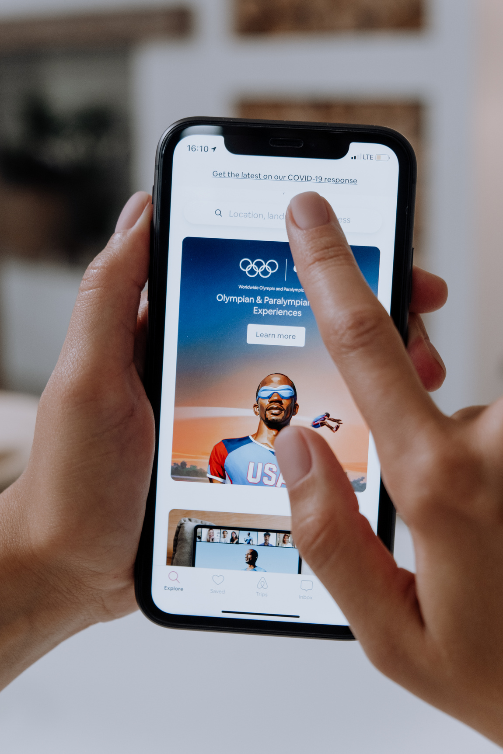
"Any sufficiently advanced technology is equivalent to magic."
Sir Arthur C. Clarke

Slide 39

Do you have
any questions?
Send it to us!
We hope you learned something new.

Slide 40





Whiteboard Page
Write a note here
Write a
note here
Tip: Collaboration makes teamwork easier! Click "Share" and invite your teammates to fill this up. Use this page for bulletins, brainstorms, and other fun team ideas.
Right-click on the background of the slide, or on the thumbnail below, for the option to expand this page into a whiteboard for more space!
Copy a note, drag to the board, and write your ideas.
Copy a note, drag to the board, and write your ideas.

Slide 41
Collaborate on a Whiteboard
Add even more sub-ideas
Add more sub-ideas
Add more sub-ideas
Add even more sub-ideas
Add a related idea
Add a main topic
Add a related idea
Add a related idea
Tip: Collaboration makes teamwork easier! Click "Share" and invite your teammates to fill this up. Use this page for bulletins, brainstorms, and other fun team ideas.
Right-click on the background of the slide, or on the thumbnail below, for the option to expand this page into a whiteboard for more space!
Add a related idea
Add more sub-ideas
Add even more sub-ideas
Add more sub-ideas
Add even more sub-ideas

Slide 42
Resource Page
Use these design resources in your Canva Presentation. Happy designing!
Don't forget to delete or hide this page before presenting.

Slide 43






























Resource Page
Use these design resources in your Canva Presentation. Happy designing!
Don't forget to delete or hide this page before presenting.

Slide 44
B for blur | C for confetti
D for a drumroll | M for mic drop
O for bubbles | Q for quiet
U for unveil | Any number from 0-9 for a timer
Resource Page
Find the magic and fun in presenting with Canva Presentations. Press the following keys while on Present mode!
Delete or hide this page
before presenting.

Slide 45
Click the Share button on the top right corner of your screen and select 'Present and Record.'
Click ‘Go to recording studio,’ where you can choose the video and audio source for your video presentation.
Feel free to choose the ‘No camera’ option and record your voice only.
Start recording, and press pause in between takes if you have to.
Once you're done, download your Canva Presentation in MP4 file format or get a link to your Talking Presentation and share it with others.
You can also record a video inside the editor! Go to 'Uploads' and click on 'Record yourself'.
Resource Page
Presenting live not your thing?
No worries! Record your Canva Presentation your audience can
watch at their own pace.
Don't forget to delete or hide this page before presenting.

